Slide 1
Welcome Parents!
English Language Arts
Ms. Provost

Slide 2
Contact and Communication
BEST WAY TO GET A HOLD OF ME: vmprovost@auburnschools.org

Slide 3
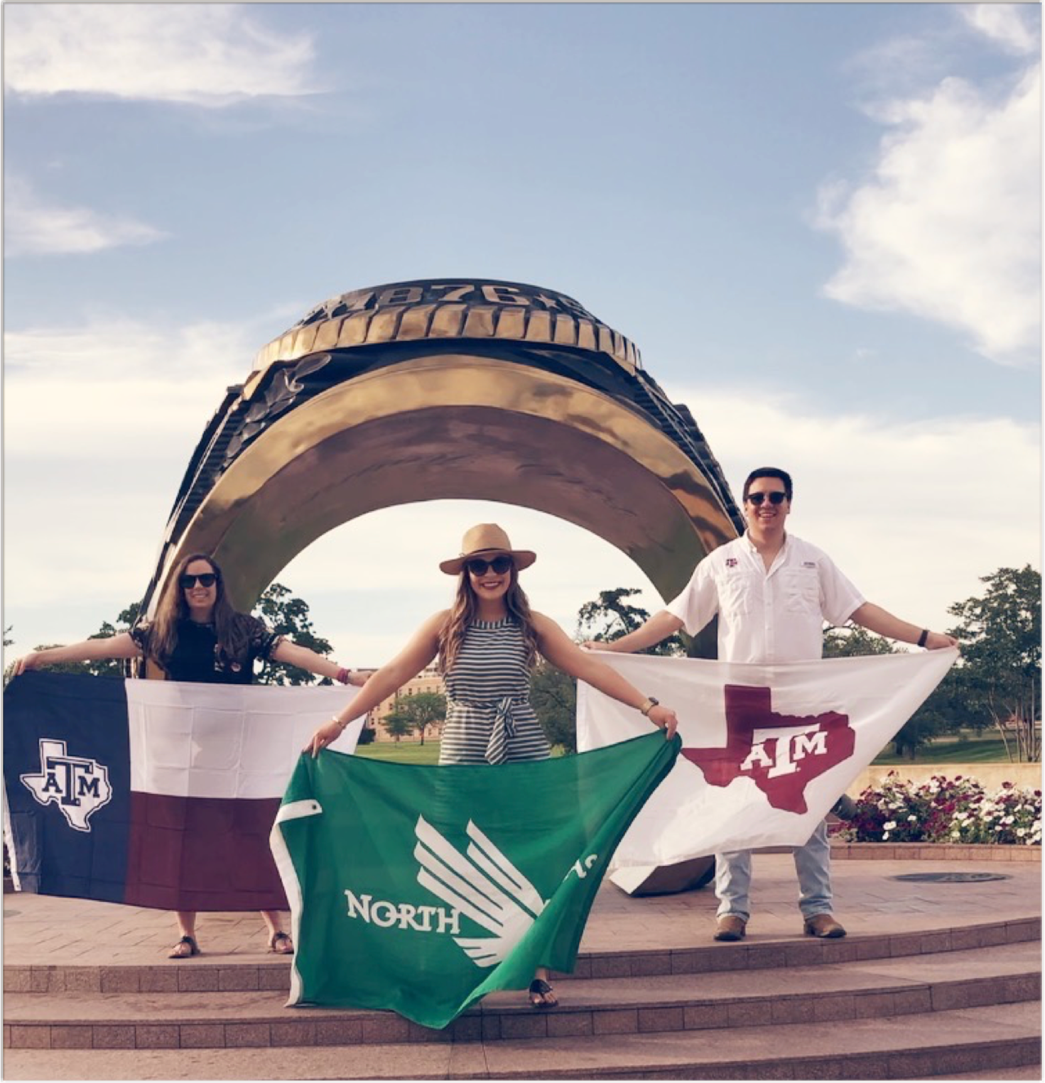
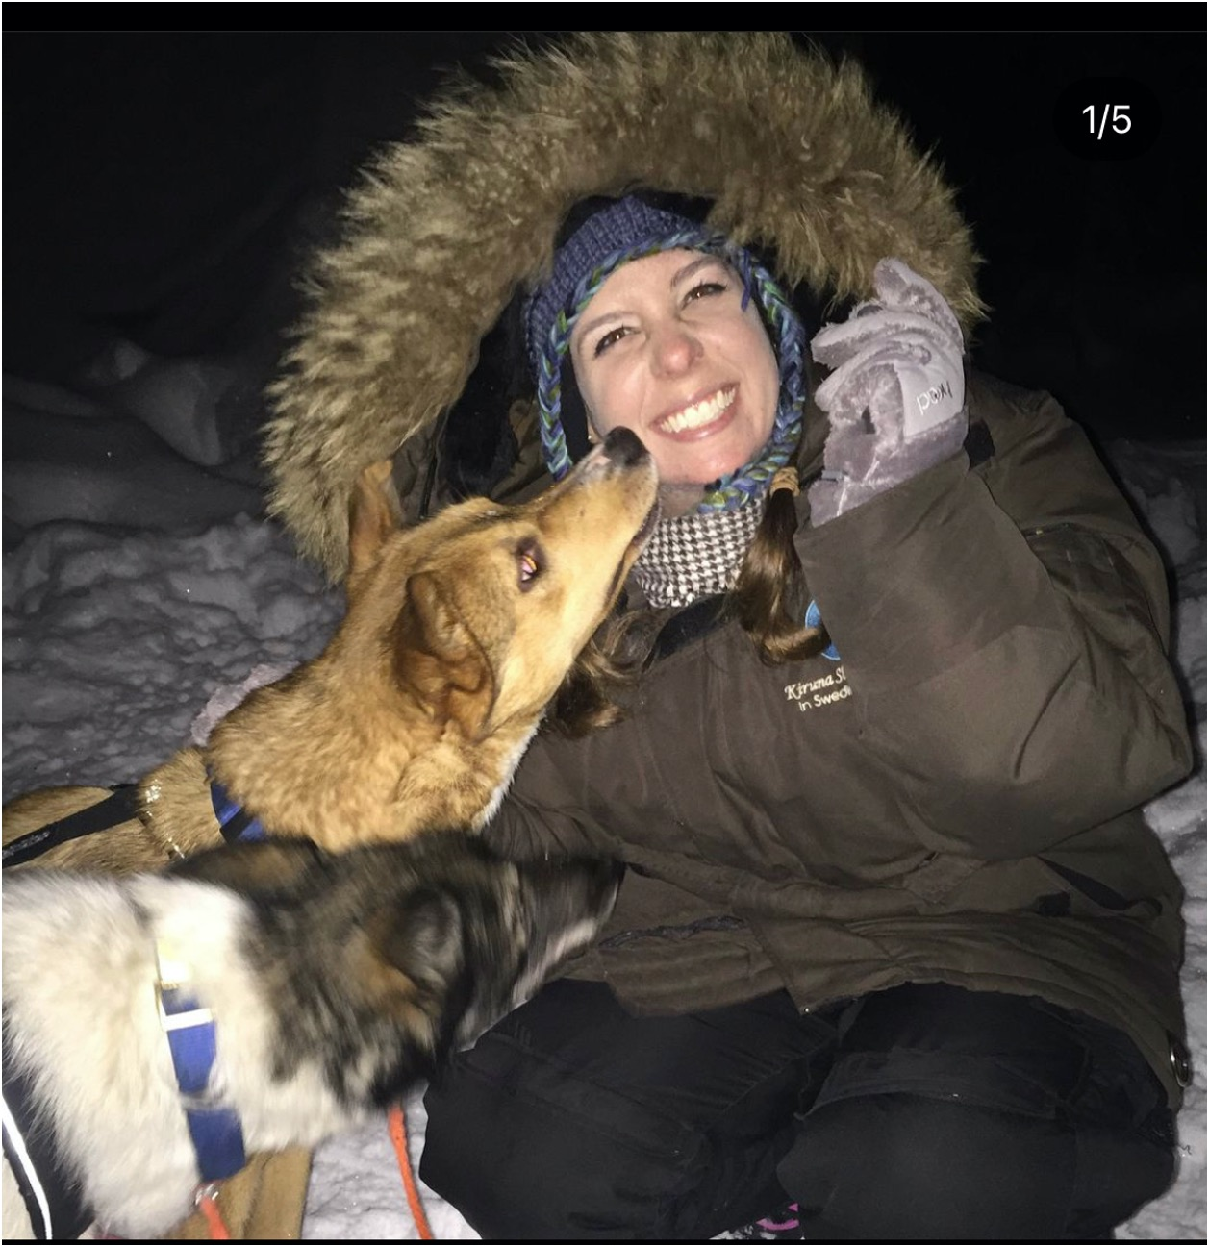
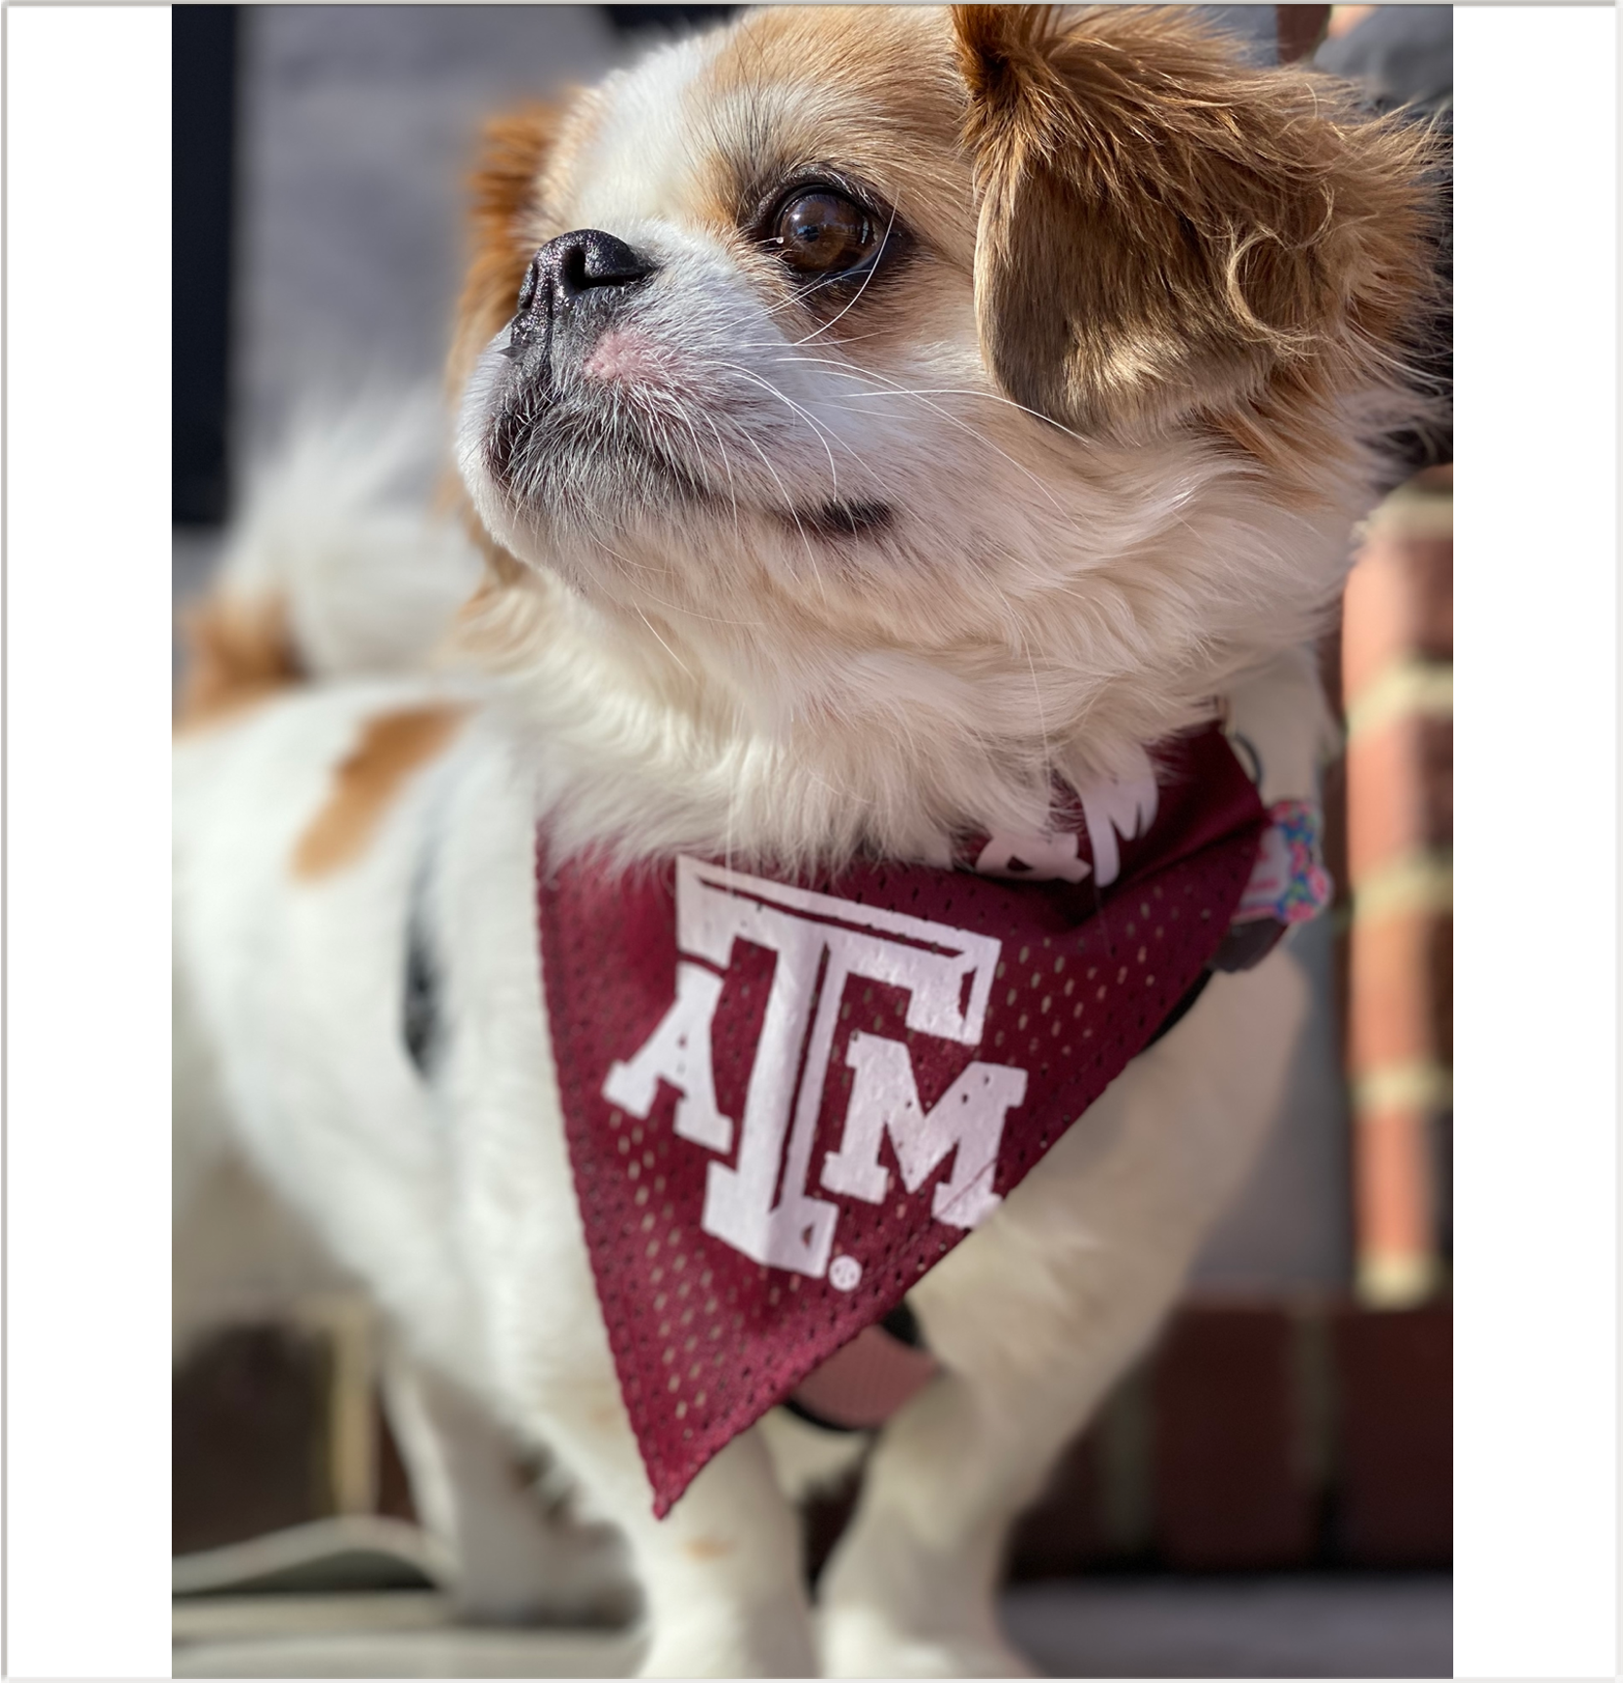
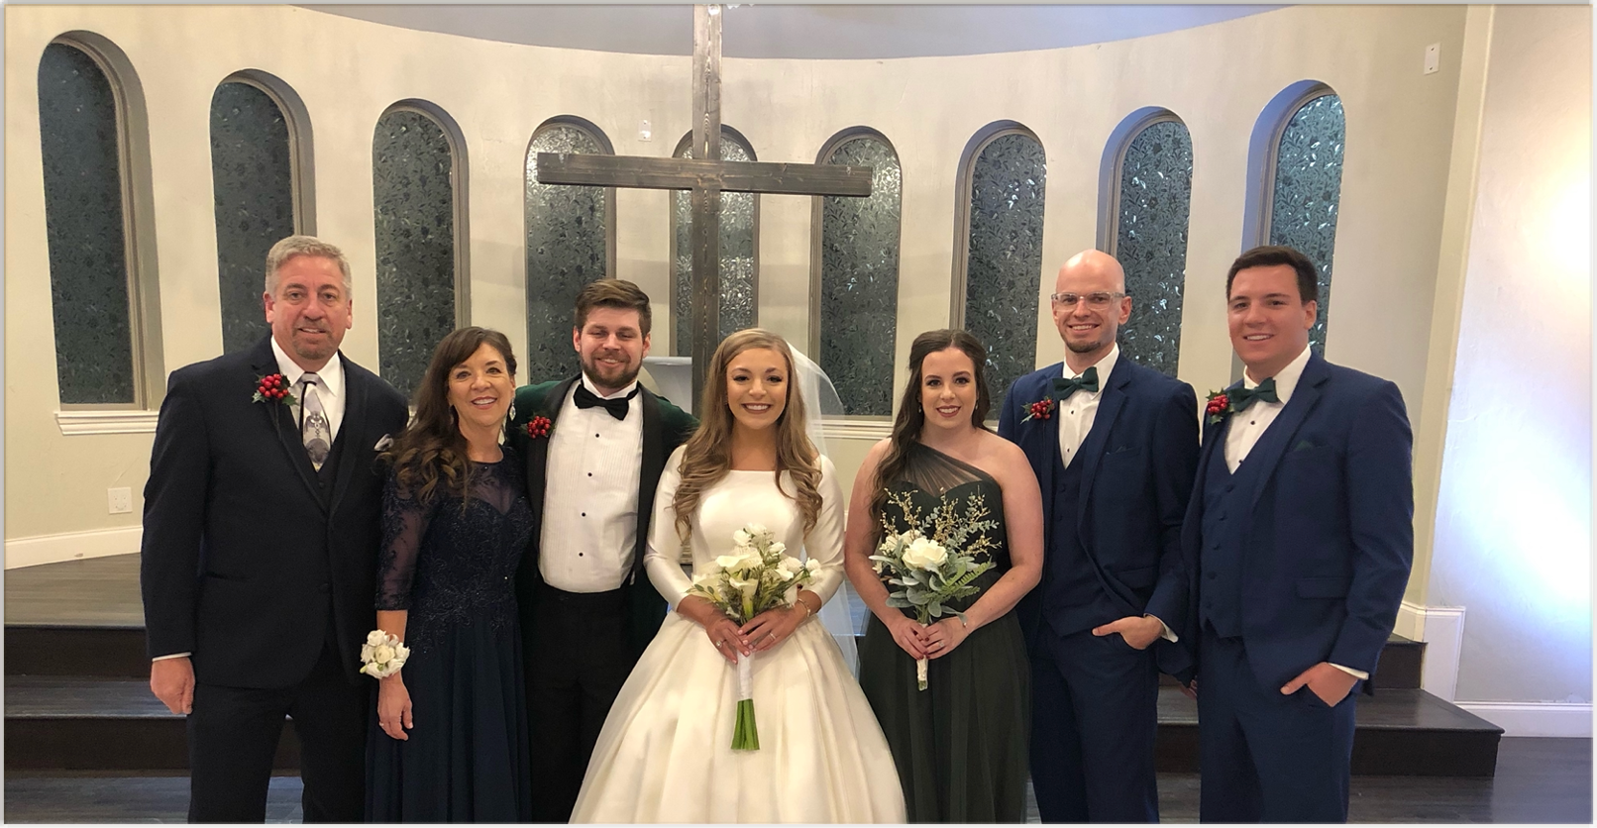
Who am I?
Born and raised in Texas
I love dogs, traveling, reading, and crafts
Attended Texas A&M University for my bachelors and Auburn University for my Masters of Education
Teaching your students is my passion!

Slide 4
If you haven’t already, please review the class syllabus with your student for more course information, expectations, and policies.
A digital copy of the syllabus can be found on their schoology

Slide 5
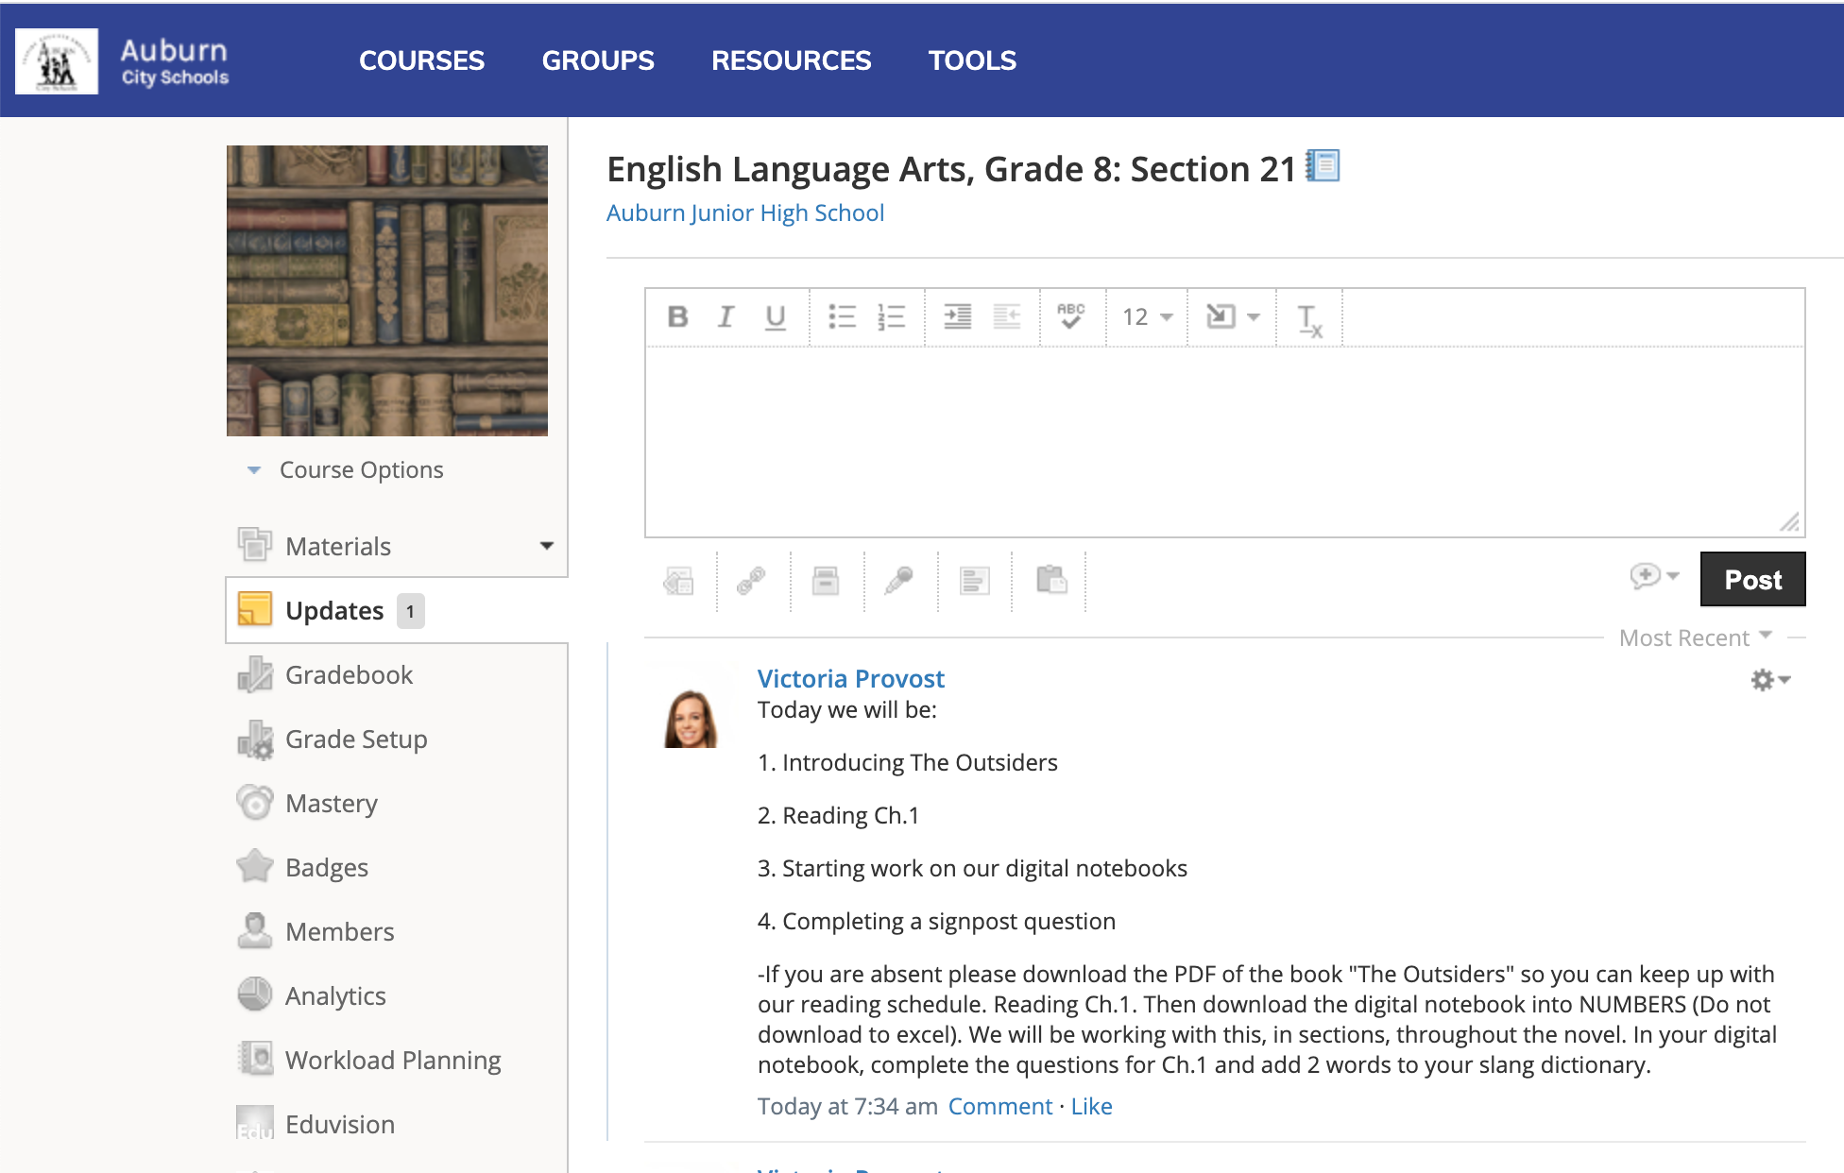
Schoology
Students will find most assignments on there
Will turn in most work there
Check the updates page for daily updates about what we are doing
If a student is absent have them check the daily updates page

Slide 6
Course Content
A brief overview of what your child will do this year:
Short stories, poems, novels, dramatic plays, narrative writing, persuasive writing, and a research project
What will they do with the literature?
Analyze, apply, determine, identify, synthesize, compare, and or contrast, the concepts, meaning, techniques, development, character evolution, and themes in a piece of literature
How will they show what they have learned?
Write essays, give presentations, collaborate with classmates, tests/quizzes, projects
Books: The Outsiders, Percy Jackson, The Diary of Anne Frank, And Then There Were None, Refugee. 1 student choice book each semester

Slide 7
Grading
50% of the average is comprised of tests, final essays, projects
35% of the average is comprised of daily grades, homework, quizzes
15% of the average comprised of the semester exam.
Progress reports every 4.5 weeks
Grades are posted quarterly
Use PowerSchool to check grades
A=90-100
B=80-89
C=70-79
D=60-69
F=59 & Below
Students have 5 days from when they get back to complete their assignments for full credit

Slide 8
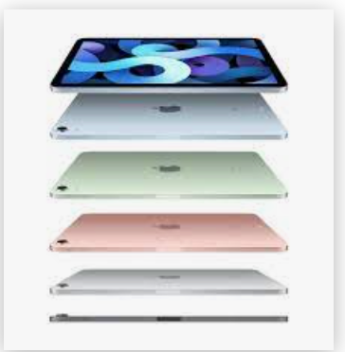
iPads
Your student will always have access to technology in my class. This is how students will usually be turning in or completing their work.
There are expectations I ask them to follow. If they are unable to follow them, the privilege may be adjusted or taken for a period of time. You will be notified as well.

Slide 9
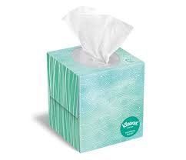
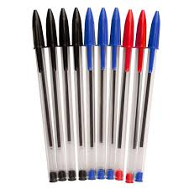
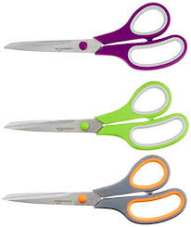
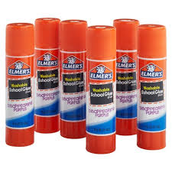
Supplies
Please make sure your student comes prepared to learn with:
Notebook paper
Pen/Pencil
Ipad
Charger
Folder
Highlighter

Slide 10
How can you help?
Responsibility--- Help your student take charge of their own learning and problem solve on their own. Please let them try to come to me first with questions or concerns. However, if it is a serious issue, please email me with your concerns. I will be more than happy to help in any way I can.
Together we can make your student more independent, take ownership of their achievements and mistakes, and help them become a self advocate.
Please do not be alarmed when I respond to your email by asking you to have your student email me or see me.

Slide 11
Thank you for coming parents!
If you have questions about anything covered or not covered tonight, or you need to address something personally, please email me.

